Slide 1
Österr.Kardiol.Gesellschaft 1990–2011 Arbeitsgruppe Intervent. Kardiologie
Monitor (Auditor) Report: 2011

Slide 2
Contact and References:
http://iik.i-med.ac.at
L.Kaltenbach, H. Ulmer, C.Kobel
www.kardiologie.insel.ch/2164.html MT Maeder -B Meier - St Cook
ESC-WG 10; F.Weidinger- Subregister
Roland Schistek; Georg Normann
www.herzbericht.de E.Bruckenberger

Slide 3
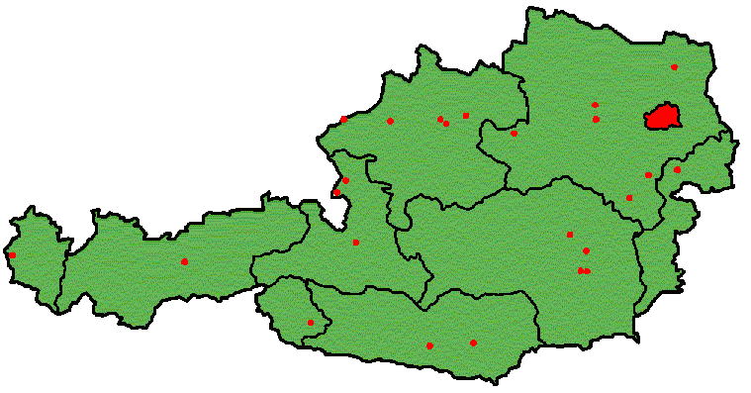
AUSTRIAN ANGIOGRAPHY +/- PCI- CENTERS 2011
4 Pediatric
37 Adult (11 in Vienna)
Rooms (n=50)
http://iik.i-med.ac.at
2010: Großgmain (-) ; Ried (?)

Slide 4
Wunschliste AUDIT 2012
AKH
Graz Uniklinik
Innsbruck
Privatklinik Josefstadt
Wiener Privatklinik
Ried i.I.

Slide 5
AUSTRIA 2009 / 2010
Angiography 52.149 55.138
PTCA=PCI 19.856 20.294
-stent 89% 92%
- - DES 69% 75%
OP-CAD (Bruckenberger : 2008=4.248) Schistek 2.737
OP- valve (Bruckenberger: 2008=2.280) Schistek 2.583

Slide 6
Coronary Angiography Frequency per Million Inhabitants 1992-2010

Slide 7
More Centres, more Tables, but not more Angios in Austria 2005-2009?

Slide 8
NUMBER OF CENTERS WITH <400 CA /year vs. <200 PCI/year vs. Number of CA/y(*t) 2000-10

Slide 9
NUMBER OF CENTERS WITH > 36 STEMI- PCI / year vs. Number of tables 2003-2010

Slide 10
PCI Frequency per One Million Inhabitants (AU/CH/D/CZ/SL/USA) 1992-2010

Slide 11
PCI Frequency in Austria 2006-2010 according to acute or non-acute Indications

Slide 12
Case load per physician PCI / CA (AU / CH)

Slide 13
% PCI/ CA 1992-2010 (AU/CH/D/CZ)

Slide 14
Ratio of: CABG-OP+PCI / per Angiography in AU CH D

Slide 15
PCI during Diagnostic Angio (%) in Austria / Switzerland / EU

Slide 16
%-multivessel PCI Austria / EU / CH

Slide 17
PCI Hospital-Mortality (%) in Austria, Switzerland,Germany, EU

Slide 18
PCI -Mortality (%) in Austria (non-acute PCI) *ref.= only

Slide 19
PCI -Mortality (%) in Austria (acute / non-acute PCI) ref.=overall-mortality

Slide 20
PCI -Mortality (%) in Austria (acute = without /with shock PCI) ref.=overall-mortality

Slide 21
PCI -Mortality (%) in Austria (non-acute / without /with shock PCI) ref.=overall-mortality

Slide 22
Number of PCI (n) for Myocardial Infarction in AU, CH

Slide 23
STEMI PCI / acute PCI/ STEMI % (n=) Austria 2007 / 2008 / 2009 / 2010

Slide 24
ACUTE PCI (% of total PCI) in AU, CZ, EU, CH (=STEMI only)

Slide 25
Ratio of emergency CABG due to PCI (%): Austria/Switzerland/EU

Slide 26
EMERGENCY CABG AFTER PCI (%): MORTALITY in Austria

Slide 27
Ratio of STENTING per PCI (%) in AU/CH/D/CZ

Slide 28
% GP IIb/IIIa for PCI (AU/CH) % ThrombinInhibitor (TI in AU)

Slide 29
Infarction as Complication (%) after PCI in Austria, CH, D, EU

Slide 30
DRUG ELUTING STENTS (DES) in AU,CH,D,EU-CZ (% of stents)

Slide 31
DRUG ELUTING STENTS (DES) in Austria (n) 2002 – 2010

Slide 32
DRUG ELUTING STENTS (DES/PCI) versus REDO/PCI in Austria (%)

Slide 33
STENT REDO: Thrombus (n/%) versus chronic Restenosis (n) in Austria

Slide 34
Puncture site closing devices (% of PCI in AU/CH)

Slide 35
Brachial/Radial Approach (n=) 37 Centers Austria 2008

Slide 36
Non- femoral Approach (% of PCI) in AU/ french or german-CH)

Slide 37
Ablation (n) / Electrophysiology (n; %) and Implantations in Austrian CathLabs

Slide 38
NEW DEVICES I, Austria 2002-2010

Slide 39
NEW DEVICES II, Austria 2002-2010

Slide 40
NEWER and OLDER DEVICES Austria 1992 -2010

Slide 41
NEW DEVICES Austria 2002 – 2010 („loser“)
Brachytherapie 163/101/28/3/0/0/0/0/0
Ultraschalltherapie 1/0/0/0/0/0/0/0/0
Transmyokardialer Laser 16/0/13/0/0/0/0/0/0
Spinal Cord Stimulation 4/0/0/0/0/0/0/0/0
Herzohrverschluss links 7/4/13/0/0/0/0/?
Stammzellth. -Katheter 21/16/23/12/40/3/0/0
stereotaktische Drahtnavigation -/-/-/-/-/33 /13/4

Slide 42
Transcatheter aortic valve implantation (TAVI; n=) in AU, CH -2010

Slide 43
benchmarking: over the years

Slide 44
benchmarking: over the centres 2010

Slide 45
benchmarking: over the centres 2010

Slide 46
.
DANKE SEHR

Slide 47
Gerinnselentferner
148/173/213/380/580/950/1065/1405/1596 (7.9%)
Bis hier
Intracoronary Pressure wire (CH= 4.2% 2009) 242(1,6%)/312/709/879/1184/1548/1649(8,3%)
Alkoholablation = PTSMA 4/4/6/15/11/16/13/30
Defektverschlüsse
162/243/269/332/214/202/296/316
Optical coherence tomogr.(OTC) -/-/-/-/ 60/113/137
perkutaner Aortenklappenersatz –/-/-/-/30/144/188

Slide 48
NOGA Mapping 16/26/26/21/65/68/50
Thrombininjektion bei lokaler Gefäßkomplikation -/ 88/143/115/77/96/120
Drug eluting Balloon 253 (2009)

